Slide 1
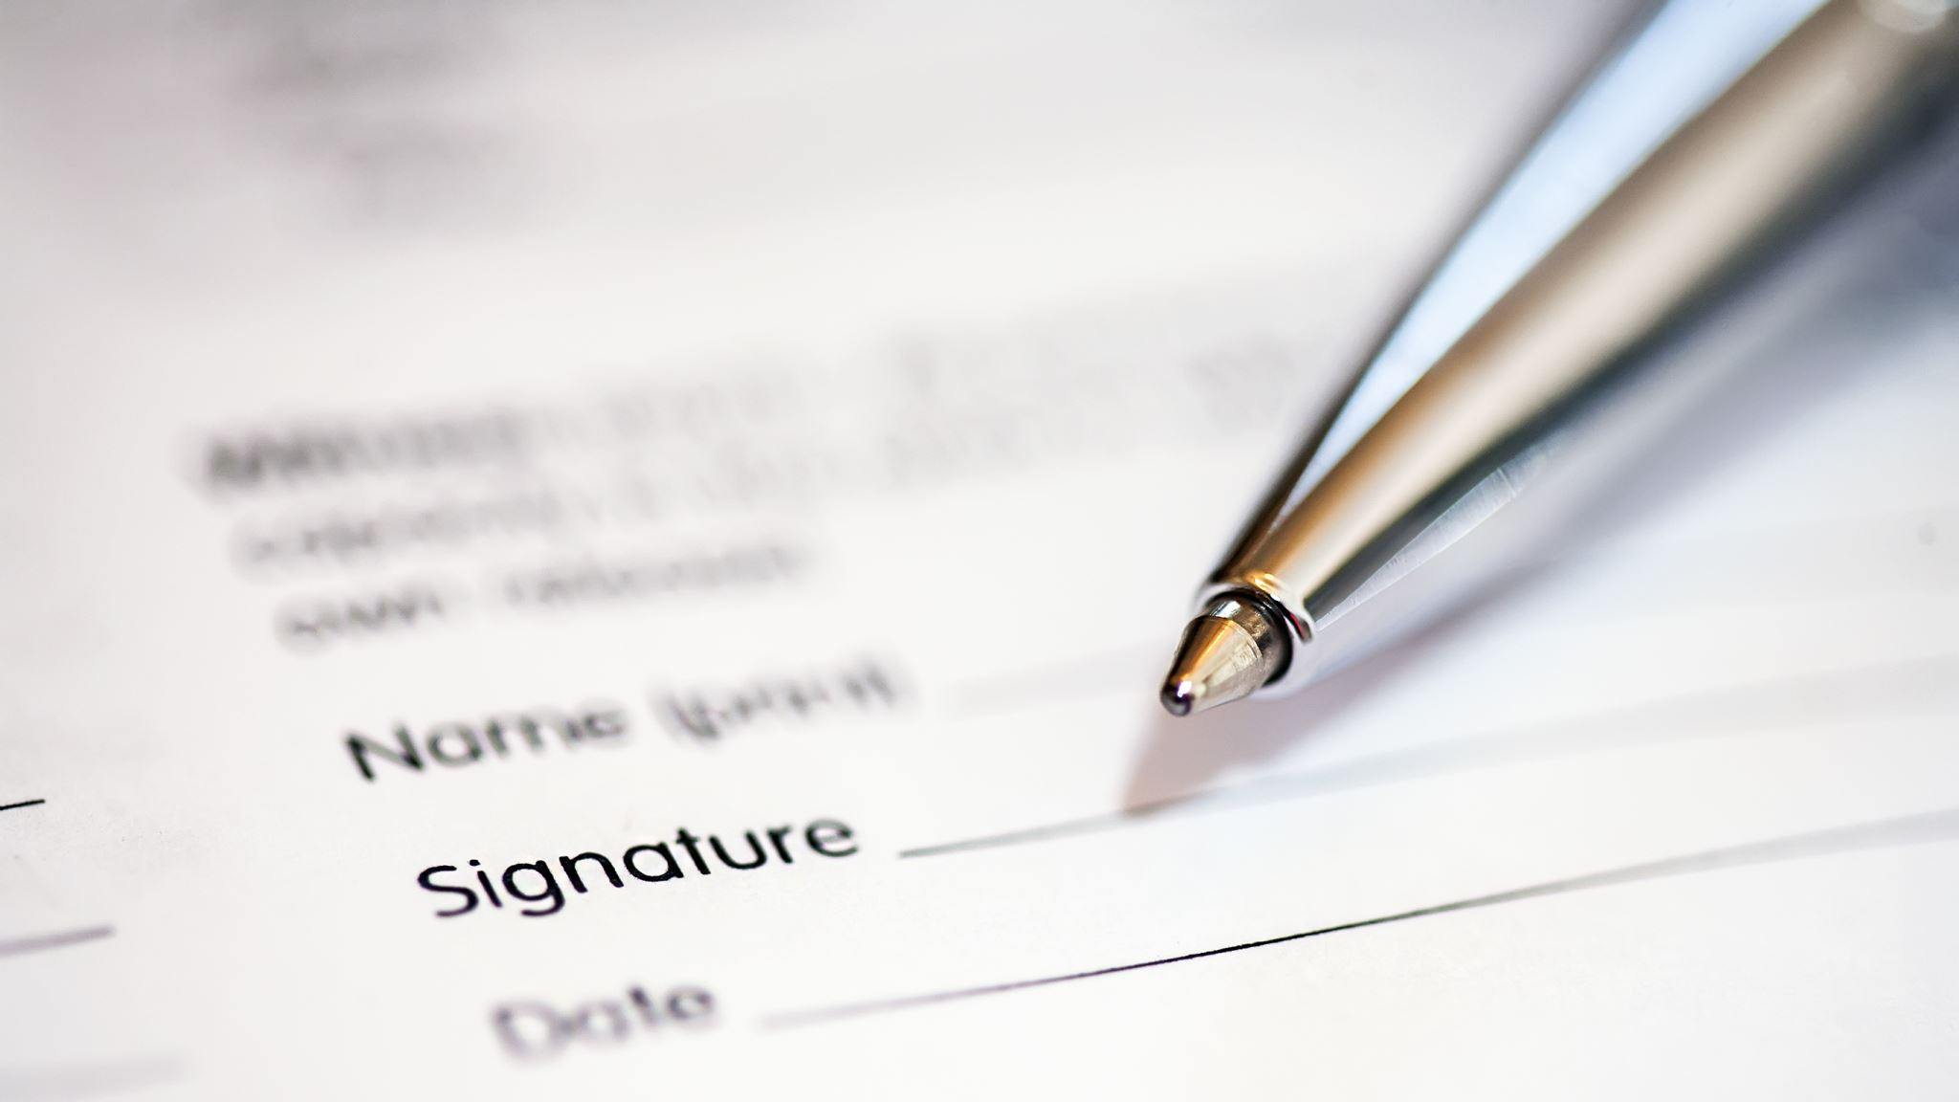
Advertisement Management Application in python
By :- Narendra Niraj (Associate IT Consultant)

Slide 2
Agenda
Introduction
Methodology
Overview
Tools & Technologies used
Modules Explained

Slide 3
Introduction
This Application is capable to manage advertisement of any individual from any domain like celebrity, industrialist, politician,etc.,
This Application is need of Time Because those who are in public domain wants to reach out to more audience and with advertisement they can reach out to audience easily.
People can manage their ads on different platform using this simple application
This Application Consist of several Modules like Registration, login, Advertisevment, platform, payment and Main Module

Slide 4

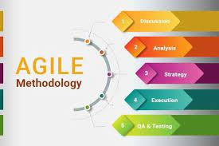
methodology

Slide 5
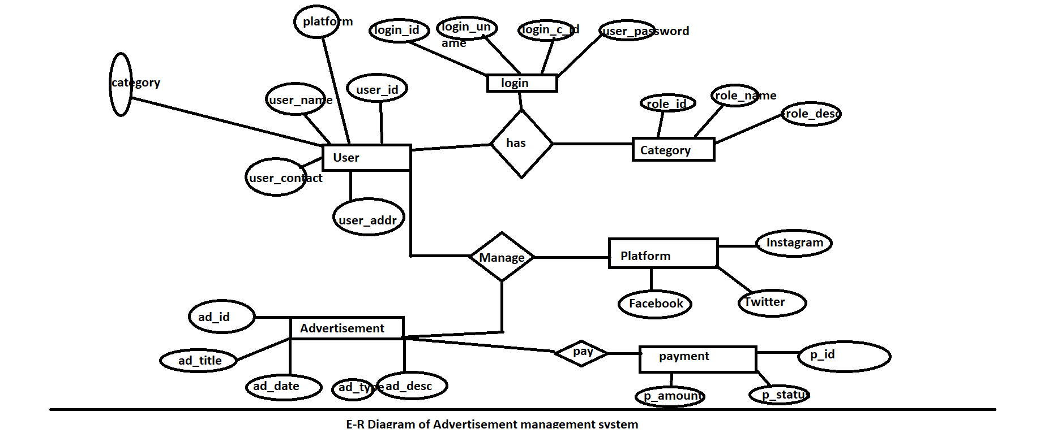
ER DIAGRAM

Slide 6
Technologies Used
Python
Git hub
Aws
PyCharm IDLE

Slide 7
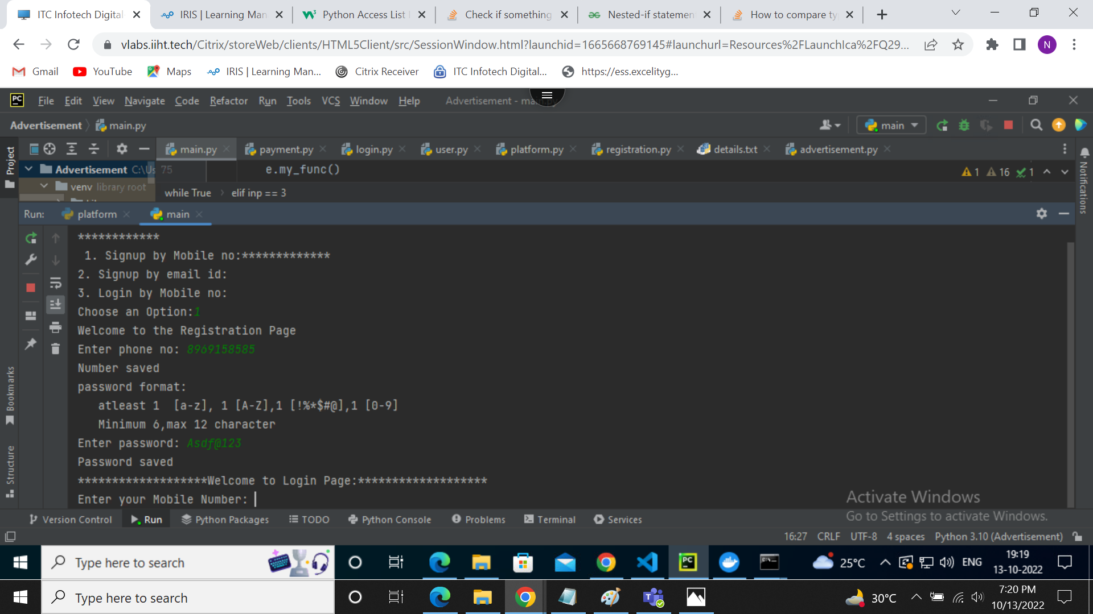
Registration Module
By the help of this module user can register themselves on our application by using mobile number or email id and password which is saved in .txt file.
Without using this module no user can proceed further.

Slide 8
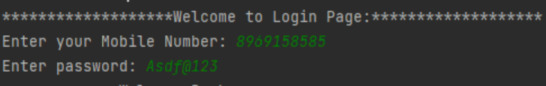
Login Module
Login Module is used to login into the application using email id or phone number and password
After login moving to the dashboard
Without login we cannot proceed to the homepage.

Slide 9
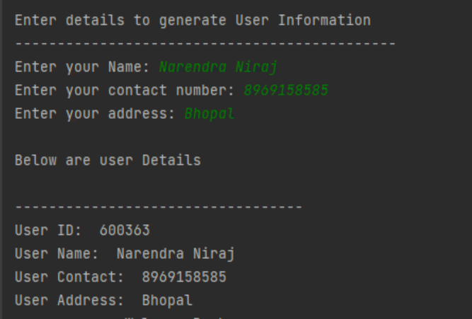
User Module
User Module is Used to take input from user like Name, contact and address.
After taking input it generate details of user with user id, username, user contact, user address.
This Module is needed for Displaying user details.

Slide 10
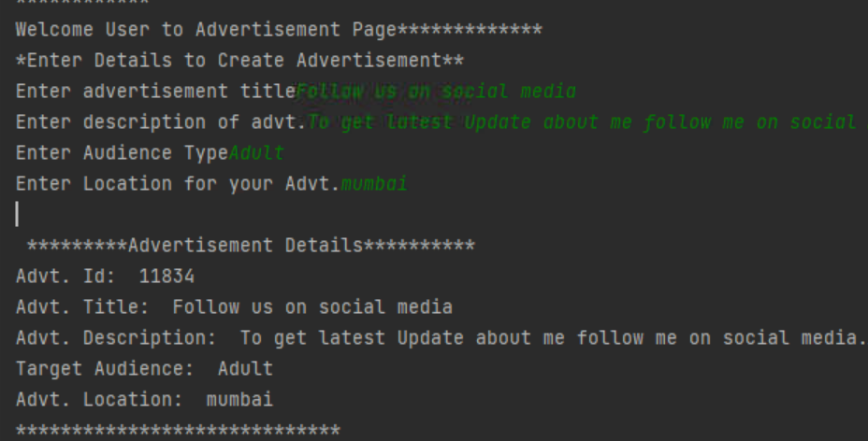
Advertisement Module
This Module is needed to take Advertisement details like Advt. Title, Advt. Desc., Target Audience, Target Location
After Taking all the input it generate Details of Advertisement.

Slide 11
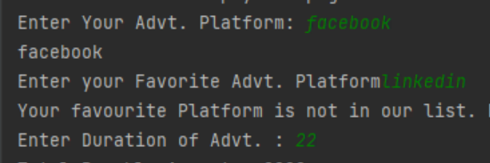
Platform Module
This Module is used to choose Platform for advertisement like facebook, instagram, twitter
This Module is also used for selecting Ad duration.
This module is used to Print Advertisement Platform.

Slide 12
Payment Module
This Module is used for Printing Payment details
Total amount is printed by checkout method
Transaction id is generated by random number and string.
Payment Details Is Printed at last.

Slide 13
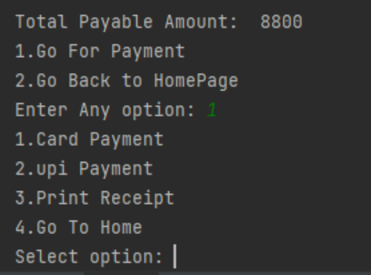

Slide 14
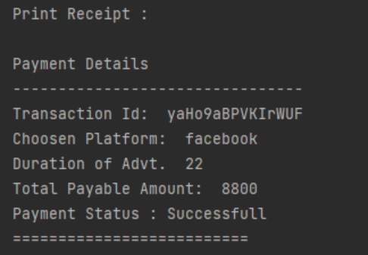
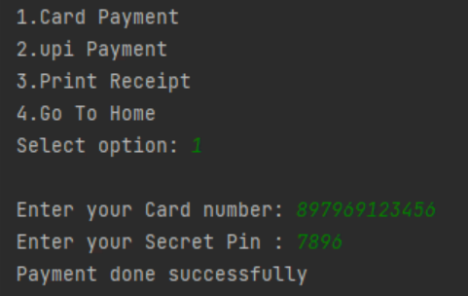
Payment Module Screenshot

Slide 15
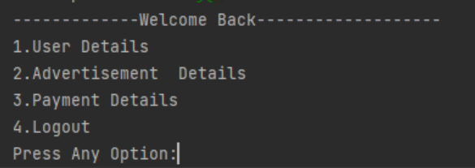
Main Module
This Module is used to combine all module at single page.
Each module is imported here.
Home Page is Child class and All others modules are parent class.

Slide 16

Thank You

Slide 17

Any Questions

